Slide 1
ANALYSIS OF CUSTOMER SATISFACTION BASED ON RECOMMENDATION STATUS
BY : Tushar Khadangle

Slide 2
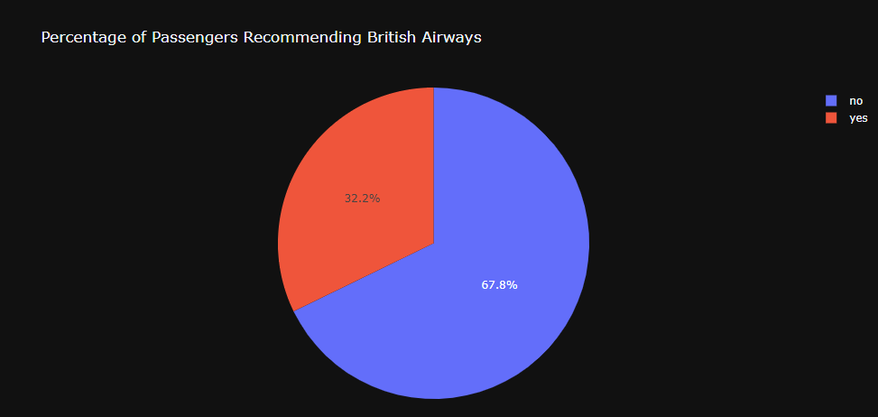
A majority of passengers recommended British Airways, reflecting overall satisfaction and trust in the airline.
Seat Comfort:
The average rating for Seat Comfort tends to be relatively good.
Cabin Staff Service:
The average rating for Cabin Staff Service is also quite positive
Food & Beverages:
Unlike Seat Comfort and Cabin Staff Service, Food & Beverages receive more mixed reviews.
efTop 10 reviews on routes
Top 10 reviews on routes
vancouver to london is rated most
rated most

